Slide 1




Slide 2

WRITING SKILLS 1.1
KEY FOR EFFECTIVE WRITING SKILLS

Slide 3
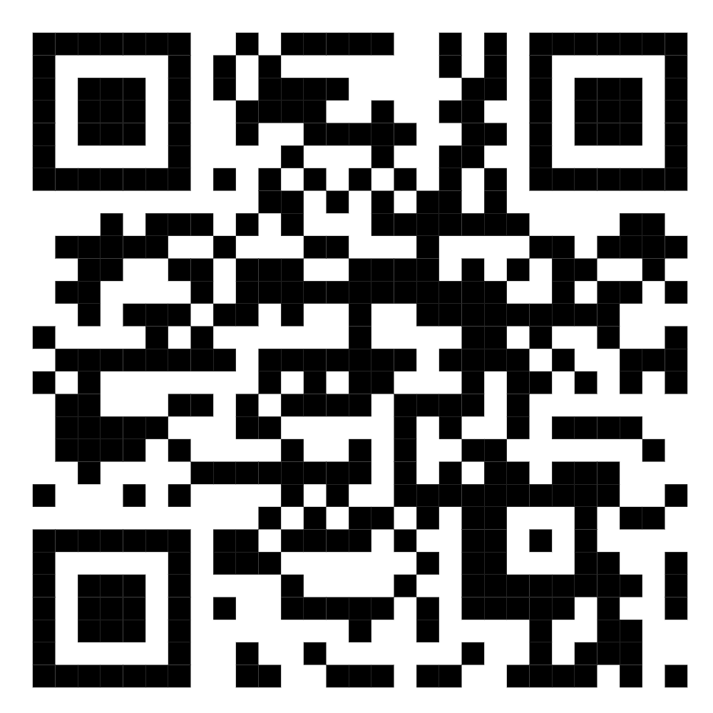
TEST TIME ON CRITICAL REASONING MIMIC THE PATTERN
QR CODE:

Slide 4

INTRODUCTION
Writing Skill
Notes:
Writing is an essential job skill, and it is a part of every job. As you advance in your career, you'll do more and more writing. Writing well will enhance your success. Indeed, promotions are often based on an employee's ability to write. This chapter provides an overview of occupational writing, to get you thinking about the important role writing will play in your career. It covers the keys to effective writing, characteristics common to most job-related writing, and the importance of writing ethically.

Slide 5
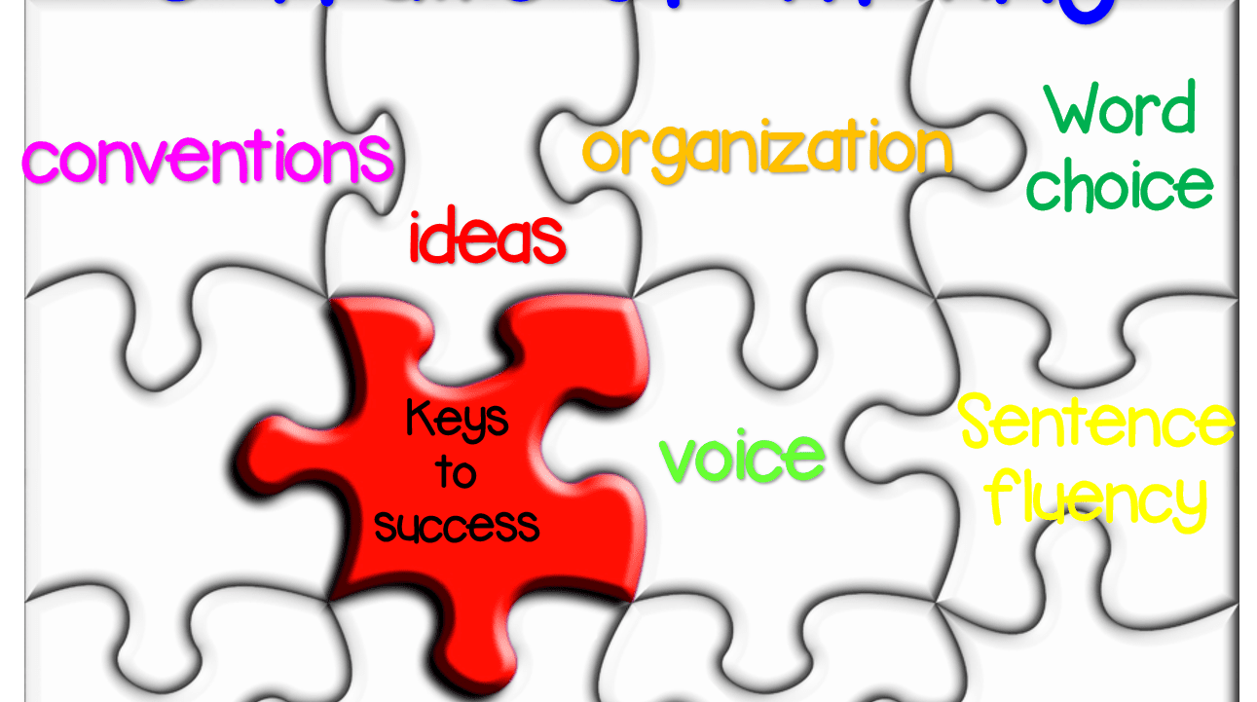
CONCEPTS
Four Keys to Effective Writing
Notes:
There are four keys to effective writing: identifying your audience, establishing your purpose, formulating your message, and selecting your style and tone. To accomplish these tasks effectively, ask yourself these questions: Who will read what I write? Why should they read what I write? What do I have to say to them? How can I best communicate?

Slide 6

CONCEPTS
Identifying your audience
Notes:
The first step in occupational writing is to ask yourself who your audience is. How big is your audience? How well do they understand English? Do they already know anything about your topic? What is their attitude toward you and your work? It is important to identify your audience before you begin writing, since you will need to tailor your message to your audience. If you are not able to identify your audience, assume a general audience and keep your writing as simple and straightforward as possible.

Slide 7

CONCEPTS
Establishing your purpose
Notes:
Identifying why you are writing will help you communicate your message better and make it easier for you to write. An important rule in occupational writing is to get to the point right away. Don't feel that you have to entertain or impress your readers.

Slide 8

CONCEPTS
Formulating your message
Notes:
Your message includes the scope and details of your communication. The details are the key points you want your readers to absorb. The scope refers to the amount of information you provide about those details. You must adapt your message to fit your audience. For example, it would not be productive to include detailed technical information in a memo for busy executives; instead, for this audience you would provide a summary of the managerial significance of these details.

Slide 9

CONCEPTS
Selecting your style and tone
Notes:
Style is how something is written. It includes such considerations as paragraph construction, sentence length and patterns, and word choice. In occupational writing, you will select a style appropriate for your message, your purpose, and your audience. Your tone expresses your attitude toward your topic and your audience. It can be formal and impersonal or informal and personal. The trend in business writing today is toward less formality; however, this does not mean you can be breezy or "chummy" in your writing. A business letter or report needs to be both personal and professional.

Slide 10

CONCEPTS
The importance of writing skills
Notes:
Style is how something is written. It includes such considerations as paragraph construction, sentence length and patterns, and word choice. In occupational writing, you will select a style appropriate for your message, your purpose, and your audience. Your tone expresses your attitude toward your topic and your audience. It can be formal and impersonal or informal and personal. The trend in business writing today is toward less formality; however, this does not mean you can be breezy or "chummy" in your writing. A business letter or report needs to be both personal and professional.

Slide 11

CONCEPTS
How writing helps you to develop
Notes:
To write well, you must organize your thoughts, explain your arguments, present your supporting evidence and lead your reader to a shared conclusion. If the reader disagrees, he or she should be able to find each of your arguments for rebuttal. Writing enables you to vividly recall past events, describe a special experience or sell a vision. You rely on critical thought in your conceptualization, on clear articulation through choice of words and structure and on effective sharing of information by writing for the reader, not just yourself. Writing harnesses the transformative power of the written word to improve your life and to change the world around you.

Slide 12

CONCEPTS
Effective writing
Notes:
Good writing targets the reading audience. It is adapted to the medium: Digital or print? Formal or informal? Light or serious? The task is accomplished if the message is communicated clearly but it is effective, if it is remembered. Skilled writing produces a response in the reader by stimulating thought, evoking an emotion and stirring to action. It is the reason you read a favourite book a second time.

Slide 13
CONCEPTS
Improve writing skills
Thankfully, writing is a skill which can be learned like any other. Furthermore, the learned skill will serve you all your life.

Slide 14
CONCEPTS
Read widely. Reading a variety of material will help to grow your vocabulary and introduce you to different styles of expression. If you read an unfamiliar word, look it up. Your reading vocabulary is larger than your written one, but you can work to reduce the gap between them by using the new words you learn in your writing.

Slide 15
CONCEPTS
Capture your ideas in writing. This requires strategic thinking in order to sharpen your focus to make ideas clearly understood.

Slide 16
CONCEPTS
Practice. The more you write, the easier it will be to develop a personal style that is recognizable. Like most skills, practice will make writing easier and more effective.

Slide 17
CONCEPTS
Target your communication. Keep your reader in mind when writing. Careful choice of appropriate words and selection of the right length of communication will help to discipline your writing.

Slide 18
CONCEPTS
Rely on good writing practices. Always read what you have written before sending it to others. A good trick is to read your work aloud, when many of its shortcoming become evident. Correct your spelling and grammatical errors. Check for organization of ideas, sentence structure and logic flow in paragraphs. Will your readers understand your message and respond the way you wish? Will you be happy with your writing if you read it much later?

Slide 19
CONCEPTS
Examine examples. Reading the Curriculum vitae of others can show you the best way to showcase your own skills and job experiences.

Slide 20
CONCEPTS
Benefit from responses and feedback. Readers responses provide valuable lessons for future writing. Questions can show you where the message was not clear. Thank readers when they quote you, repeat your message or share your writing with others.

Slide 21




THANK YOU
+91 78150 95095
codemithra@ethnus.com
www.codemithra.com

